Slide 1
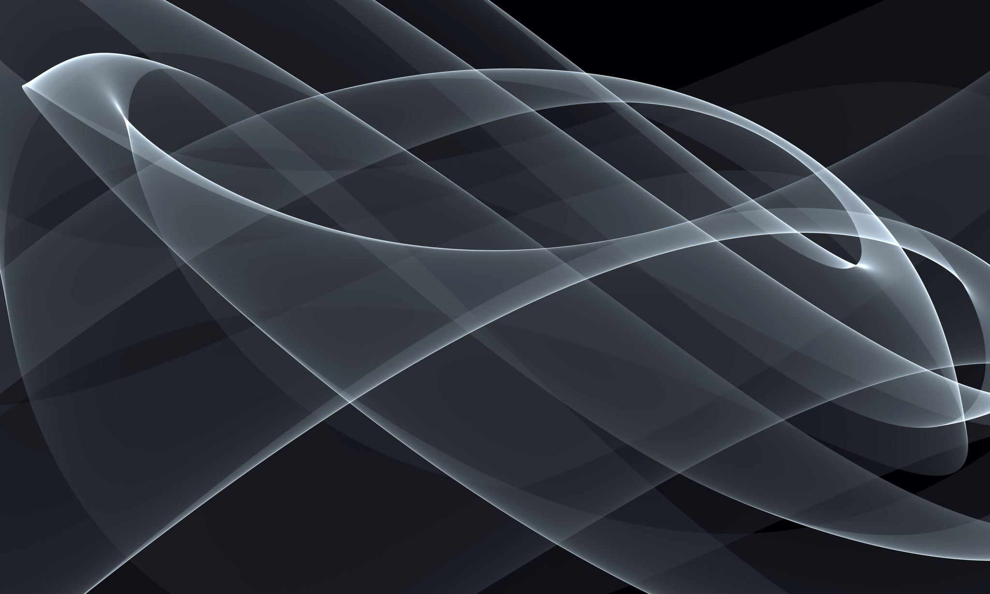
ESRGAN: Enhanced Super-Resolution Generative Adversarial Networks Xintao Wang¹, Ke Yu¹, Shixiang Wu², Jinjin Gu³, Yihao Liu⁴, Chao Dong², Chen Change Loy⁵, Yu Qiao², Xiaoou Tang¹
Implementation by
Danish Behnal (190010018)
Ayan Agrawal (190100030)

Slide 2
Brief Introduction
The Super-Resolution Generative Adversarial Network (SRGAN) is a seminal work that can generate realistic textures during single image super-resolution.
However, the hallucinated details are often accompanied with unpleasant artifacts. To further enhance the visual quality, we thoroughly study three key components of SRGAN –
network architecture
adversarial loss
perceptual loss
and improve each of them to derive an Enhanced SRGAN (ESRGAN).

Slide 3
Proposed Methods for ESRGAN

Slide 4
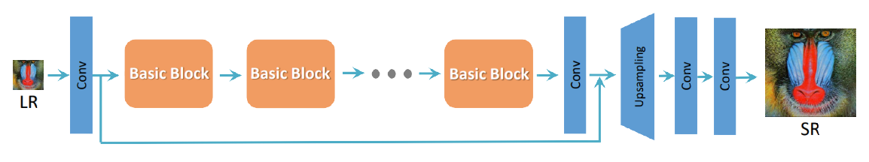
Proposed Methods
The basic architecture of SRResNet is used here which was also used in SRGAN, where most computation is done in the LR feature space, after which the image is upsampled. We could select or design “basic blocks” (e.g RRDB) for better performance

Slide 5
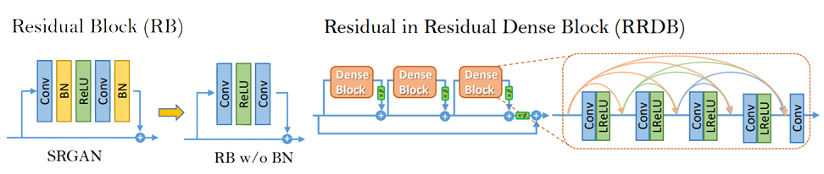
Network Architecture
In order to further improve the recovered image quality of SRGAN, we mainly make two modifications to the structure of generator G:
1) remove all BN (Batch Normalization) layers
2) replace the original basic block with the proposed Residual-in-Residual Dense Block (RRDB), which combines multi-level residual network and dense connections as depicted

Slide 6
Generator

Slide 7
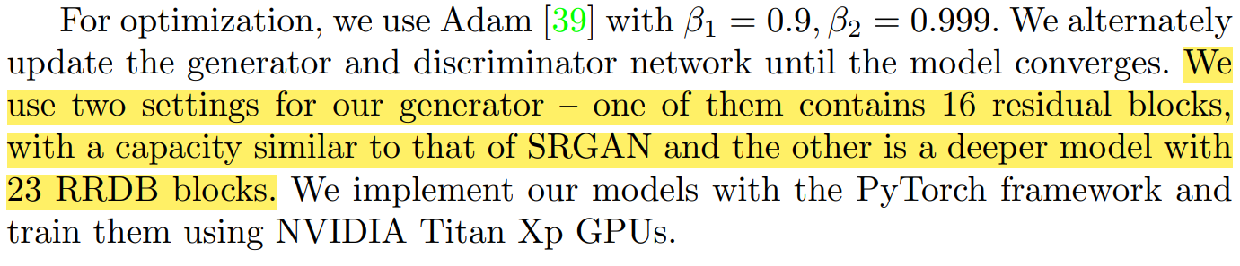
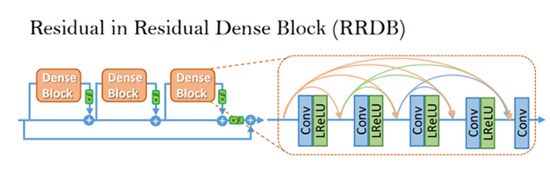
Let’s review the model before implementing
From the Paper
For our Generator, there are 23 RRDB block
The RRDB block is made up of 3 Dense Residual Block
This Dense Residual Block is further made up of a CNN and a LeakyReLU

Slide 8
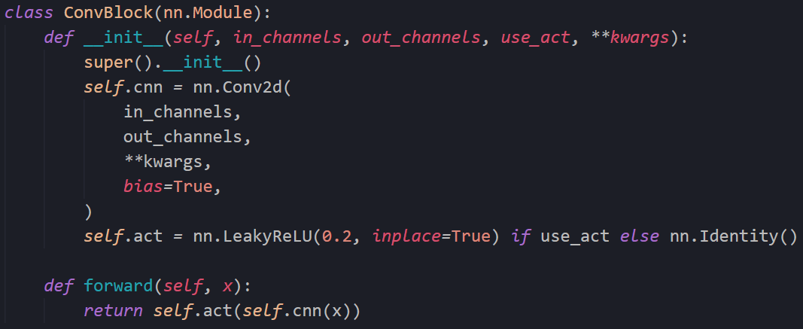
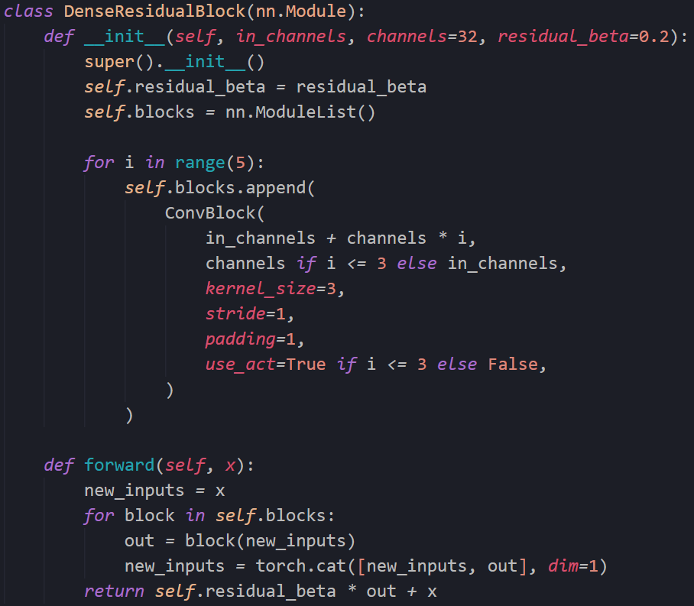
Implementation
A conv block made up of a CNN and a LeakyReLU.
And the Dense Residual Block is made up of these concatenated ConvBlock.
residual beta (=0.2) is used to scale down the residuals by multiplying a constant between 0 and 1 before adding them to the main path to prevent instability.

Slide 9
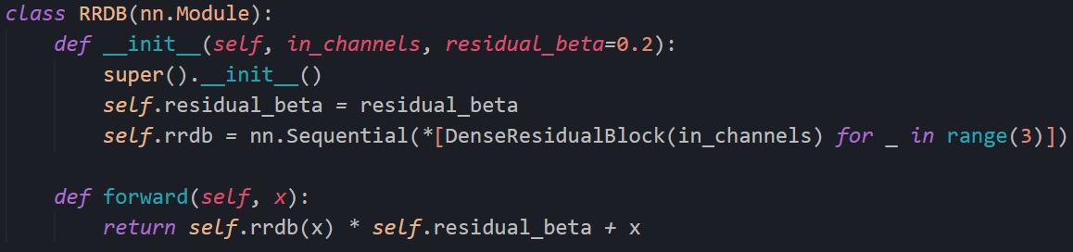
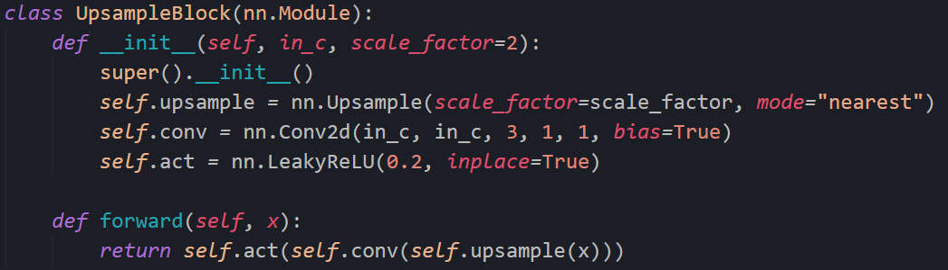
The RRDB is then made up of 3 Dense Residual Blocks
And then the Upsampling Block is based on the nearest neighbour with a scaling factor of 2

Slide 10
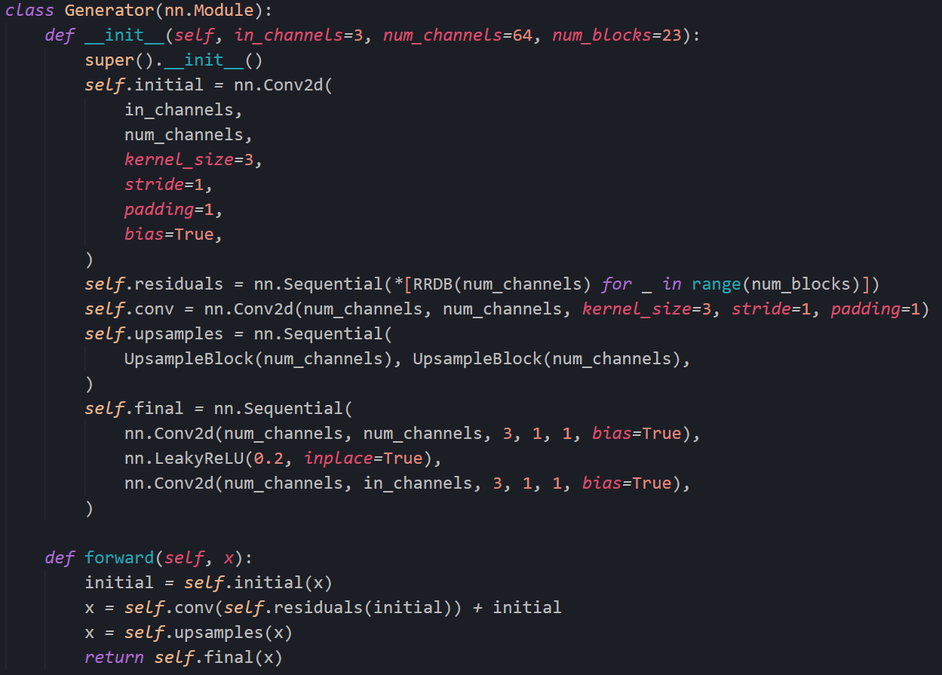
Finally, adding 23 of these RRDB blocks.
And followed by a Upsampling blocks and 2 Conv layers with LeakyReLU which gives us the Generator.

Slide 11
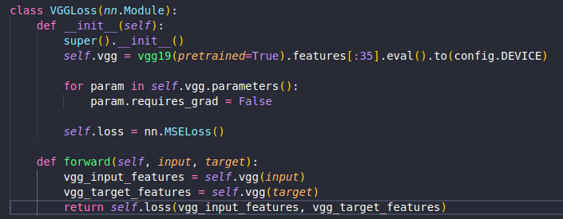
Losses
NOTE: For simplicity, we would be using the Standard Discriminator (VGGLoss) instead of the Relativistic Discriminator which used in the paper.
Although this would result in a softer edges with less detailed textures.
This step was necessary to reduce training time of the Network. The benefit of using the Relativistic GAN was not significant so we used a simple loss function.
Perceptual loss was previously defined on the activation layers of a pre-trained deep network, where the distance between two activated features is minimized.
First, the activated features are very sparse, especially after a very deep network
Second, using features after activation also causes inconsistent reconstructed brightness compared with the ground-truth image

Slide 12
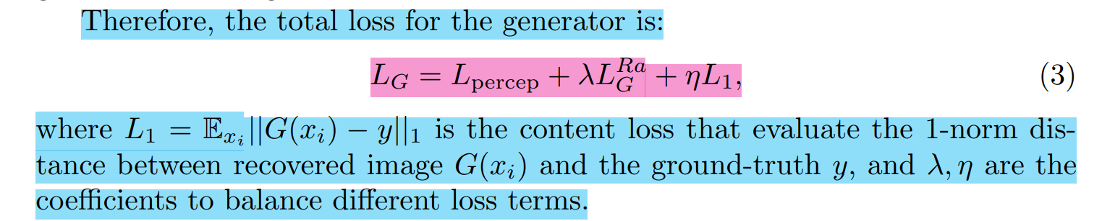
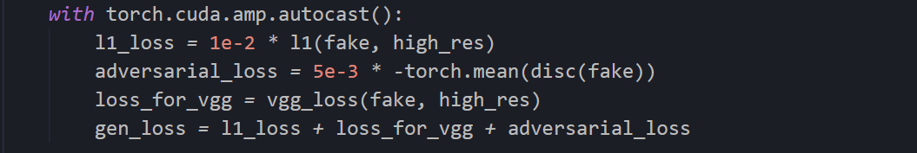
Where ⴄ= 1e-2 and λ=5e-3
In train.py

Slide 13
Discriminator

Slide 14
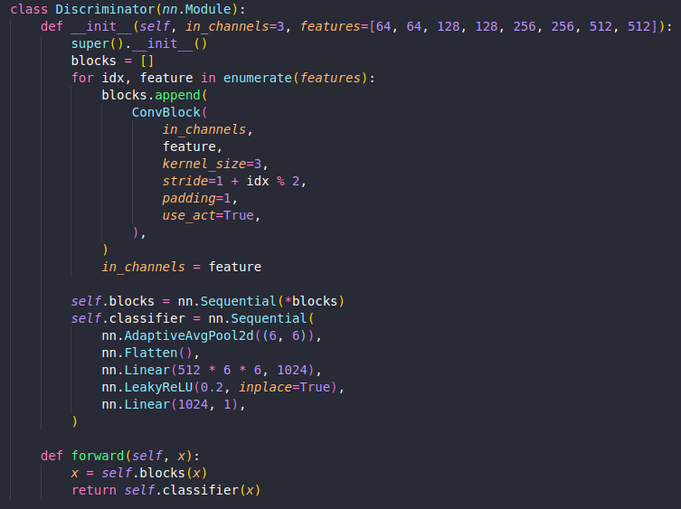
Implementation
Now as far as the Discriminator is concerned its architecture is similar to that of the VGG19 network.
The only major change in the network is the last output node where we now want only a single output.
We used transfer learning for the discriminator to speed up our process.

Slide 15
Results

Slide 16
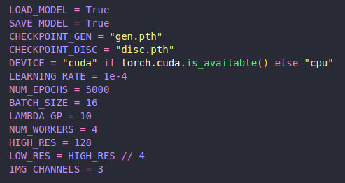
We would like to thank our Friends in UMIC for lending us their Desktop for Training the network.
The train loop was run for 5000 epochs against the 10000 epochs mentioned in the paper due to less Computational resources.
The model was only trained on the DIV2K dataset, containing 800 High Resolution Image.
The spatial size of cropped HR patch was 128 × 128.
As far as the data augmentation goes we used random horizontal flips of 90° while training.
We also normalized our images to mean of 0 and Std Deviation of 1.

Slide 17
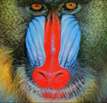


LR Image
Our Output
Ground Truth

Slide 18
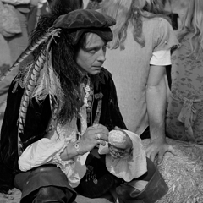
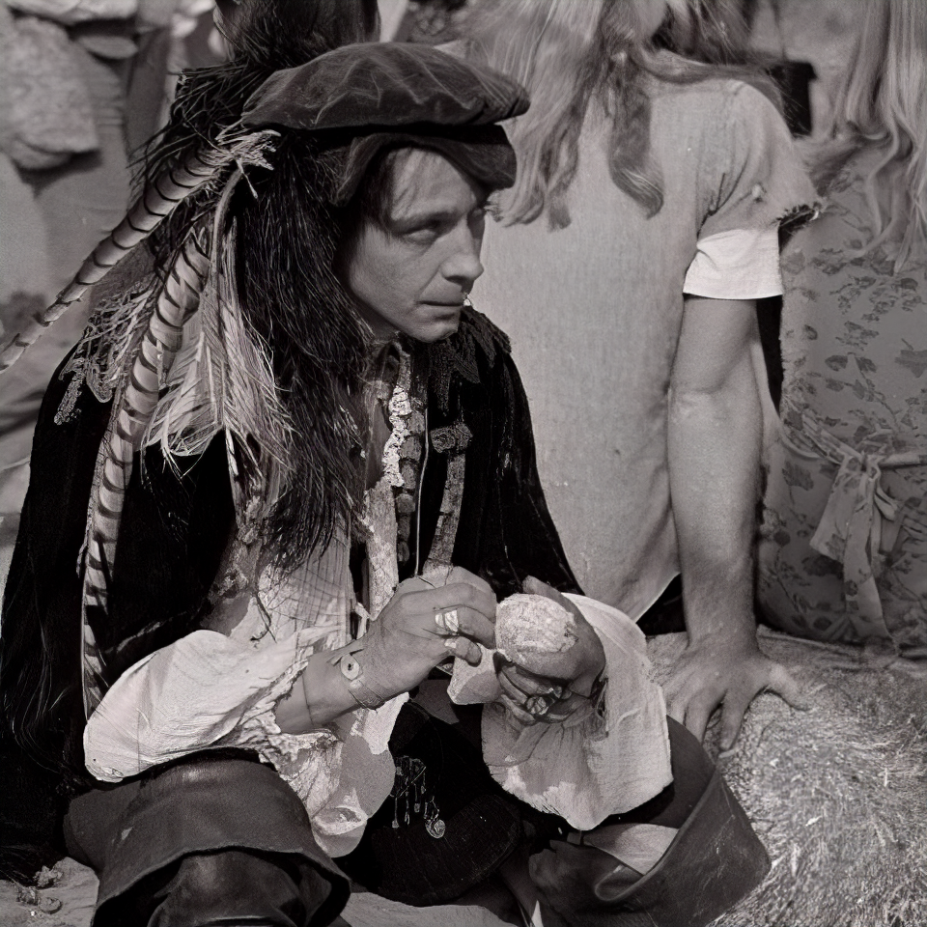
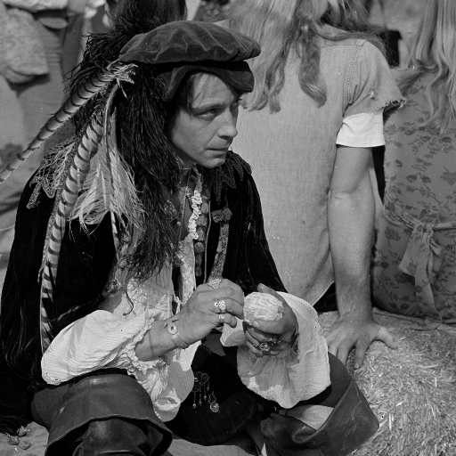
LR Image
Our Output
Ground Truth

Slide 19



LR Image
Our Output
Ground Truth

Slide 20



LR Image
Our Output
Ground Truth

Slide 21
Conclusion
Since the rest of the code is similar to the SRGAN, it has been left out for the explanation.
This concludes the implementation of the model of ESRGAN.
The code and the weights would be provided in Moodle/GDrive.
Thank You for making it so far!

